Slide 1
Brand Guidelines
How to enable an agency to access the website

Slide 2

Brandguidelines.bracco.com
Agency registration
Login Requirements
Agency Invitation request
Agency Registration Process
Agency Registration Process - MFA configuration
Login

Slide 3
For bracco marketing

Slide 4

Brandguidelines.bracco.com
Login requirements
The access to the website is granted to all account registered in Bracco Active Directory ( Microsoft Entra ).
The Agency’s email address should be created as Guest user by Marketing department using this link:
https://portal.azure.com/#view/Microsoft_AAD_UsersAndTenants/InviteUser.ReactView

Slide 5
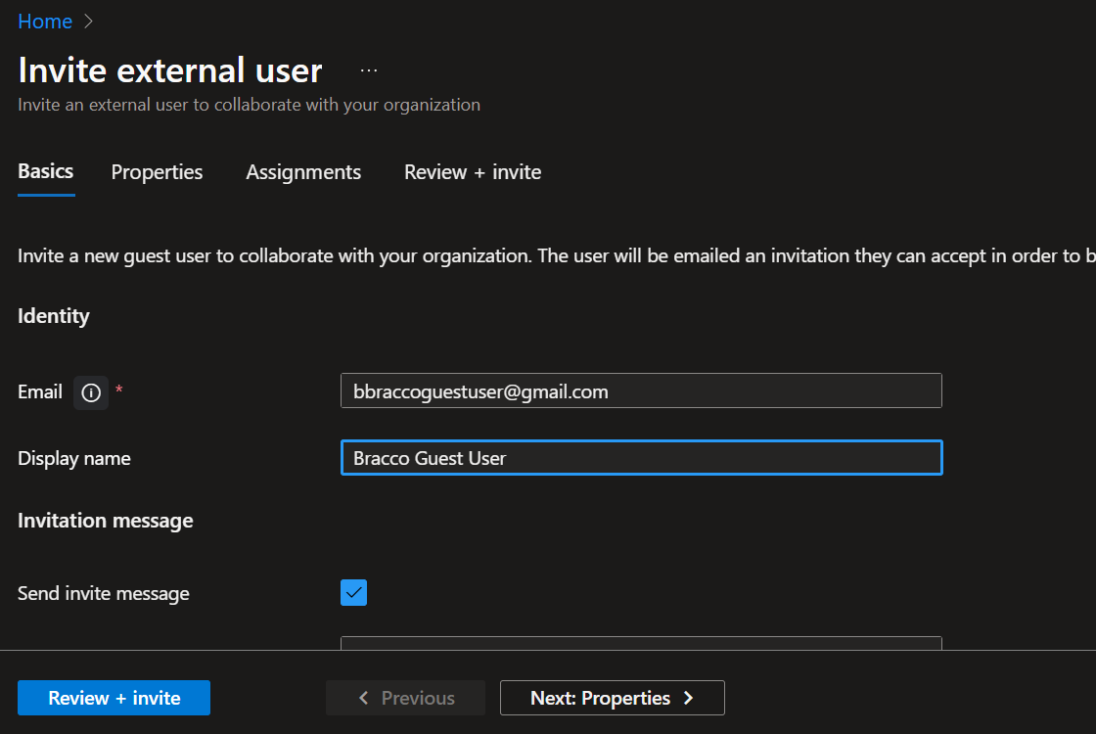



Brandguidelines.bracco.com
Agency Invitation Request
To fill in :
  Email Address
  Display name
Click on Review+Invite
Then click on Invite

Slide 6
For External agency

Slide 7
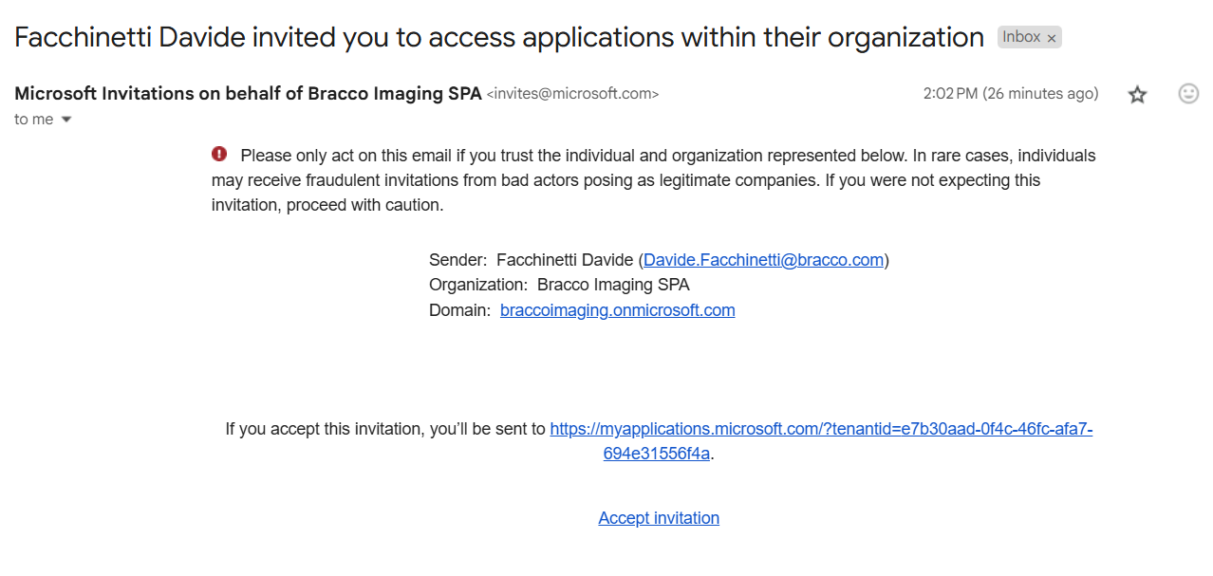
Brandguidelines.bracco.com
Agency Registration process
The agency will receive an mail as in the right .
Click on Accept Invitation link

Slide 8
Brandguidelines.bracco.com
Agency Registration process
A form with a Password request is presented?
It means that the email provided by the agency is already used as Microsoft Account. If you are not aware about the password follow the process for Password reset.
After authentication you will be able to login to https://brandguidelines.bracco.com
Otherwise see next slide.

Slide 9
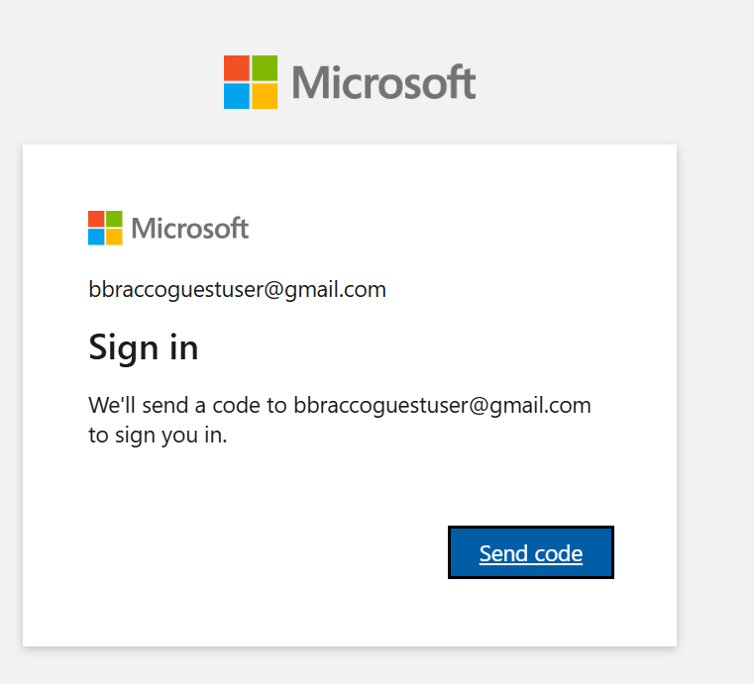
Brandguidelines.bracco.com
Agency Registration process
Click on Send Code.
An One Time Password code will be sent to the email address .

Slide 10
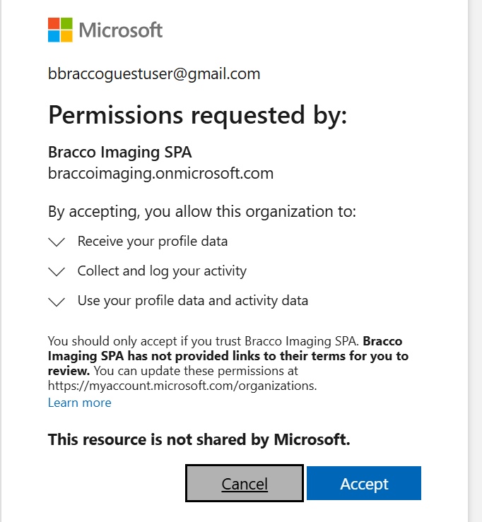
Brandguidelines.bracco.com
Agency Registration process
Enter the One Time Password code and then click on Accept.

Slide 11
Brandguidelines.bracco.com
Agency Registration Process – MFA Configuration
Bracco requires the Multifactor authentication to access group sites.
Please follow the process in order to configure the Microsoft Authenticator App for Bracco Account .
Click on Accept

Slide 12
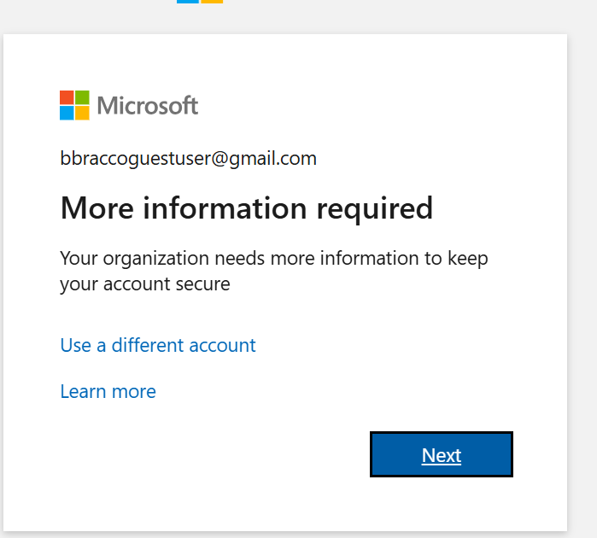
Brandguidelines.bracco.com
Agency Registration Process – MFA Configuration
Click on Next

Slide 13
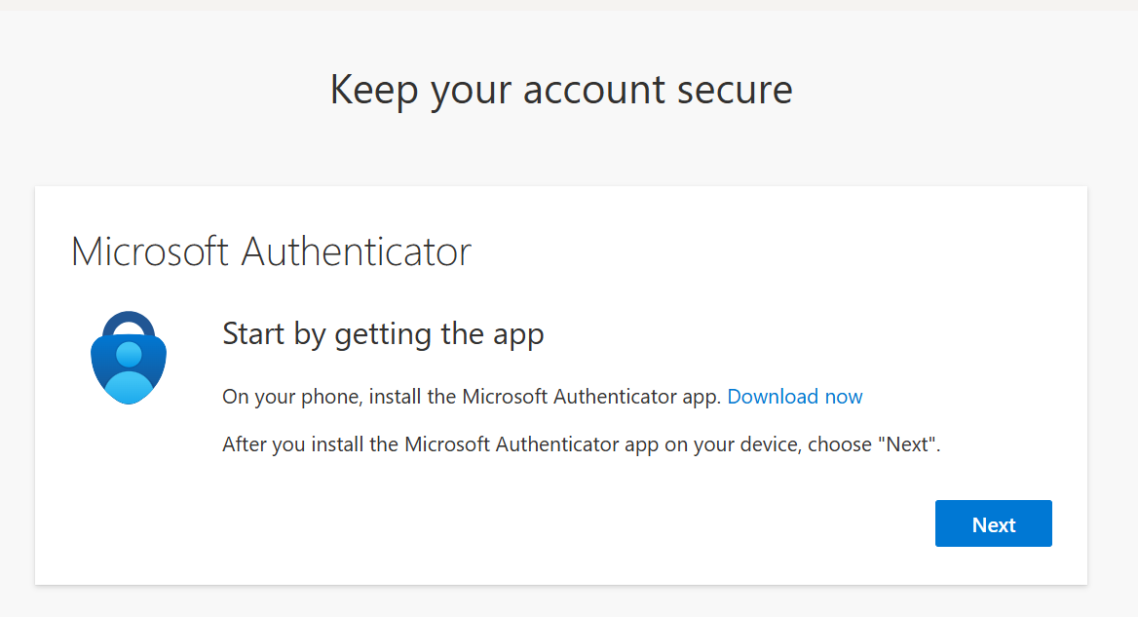
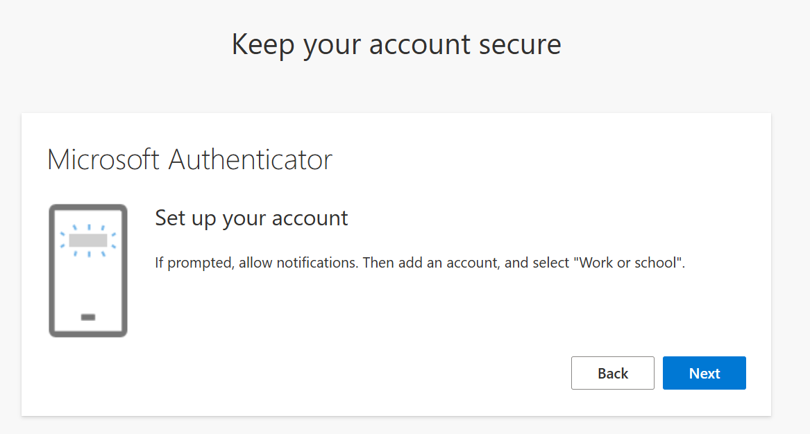
Brandguidelines.bracco.com
Agency Registration Process – MFA Configuration
Download and install on mobile phone the Microsoft Authenticator app .
Follow the process click on Next

Slide 14
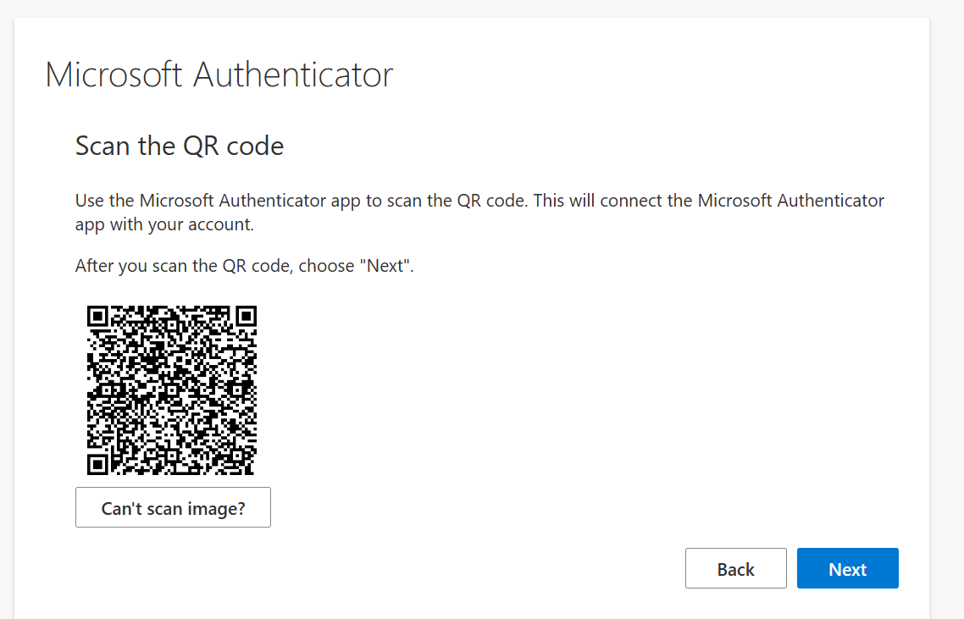
Brandguidelines.bracco.com
Agency Registration Process – MFA Configuration
Using the Microsoft Authenticator App scan the Qrcode showed on the computer screen.

Slide 15
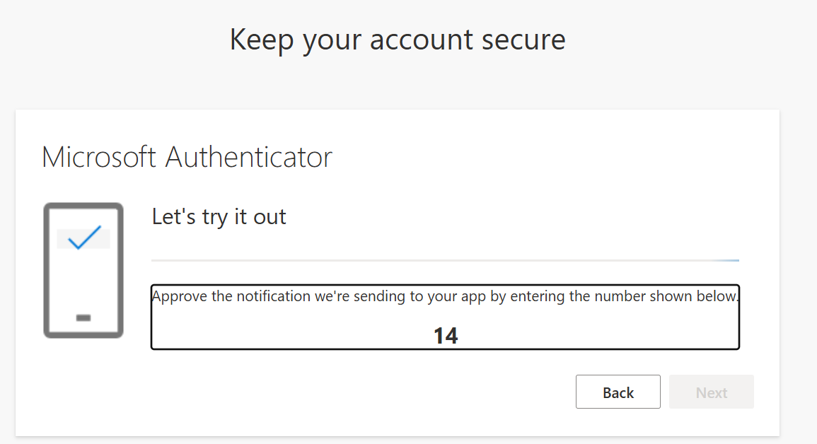
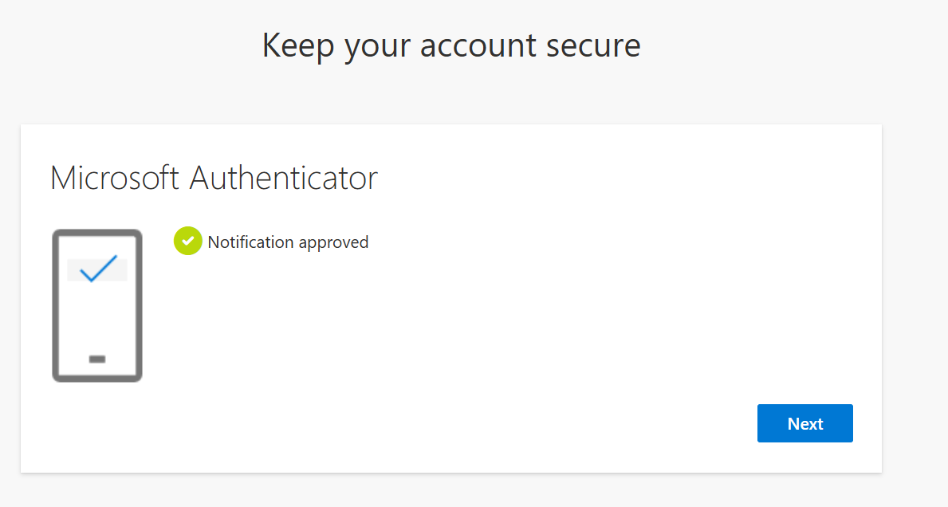
Brandguidelines.bracco.com
Agency Registration Process – MFA Configuration
Follow the istruction to complete the MFA configuration.

Slide 16
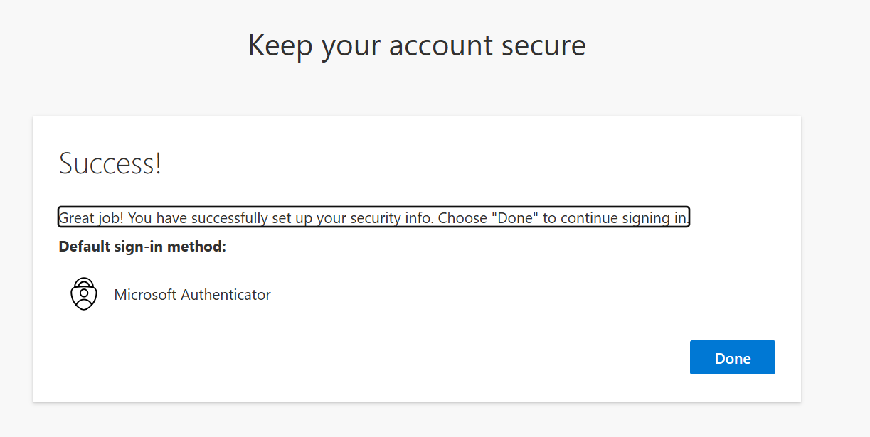
Brandguidelines.bracco.com
Agency Registration Process – MFA Configuration
Registration process completed.

Slide 17
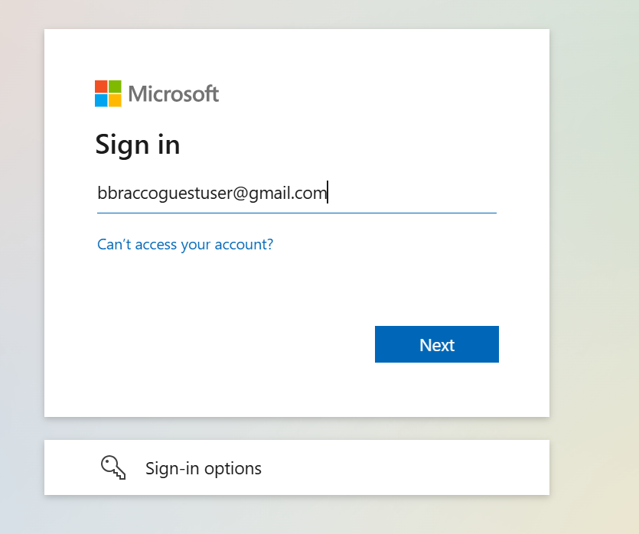
Brandguidelines.bracco.com
Login
Click on the link
Fill in the email used for the registration
https://brandguidelines.bracco.com/

Slide 18
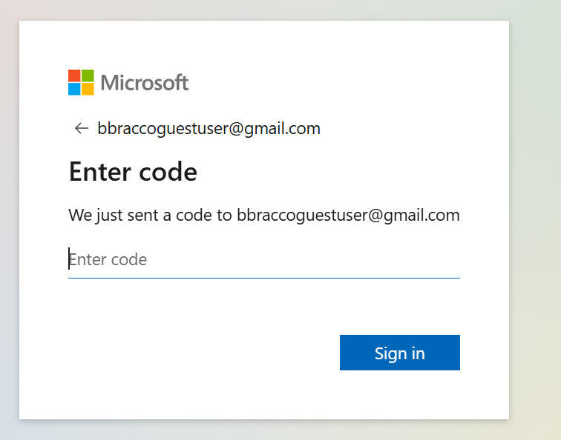
Brandguidelines.bracco.com
Login
Enter the One Time Password code sent in the email box.
Authorize the login on Microsoft Authenticator App.

Slide 19
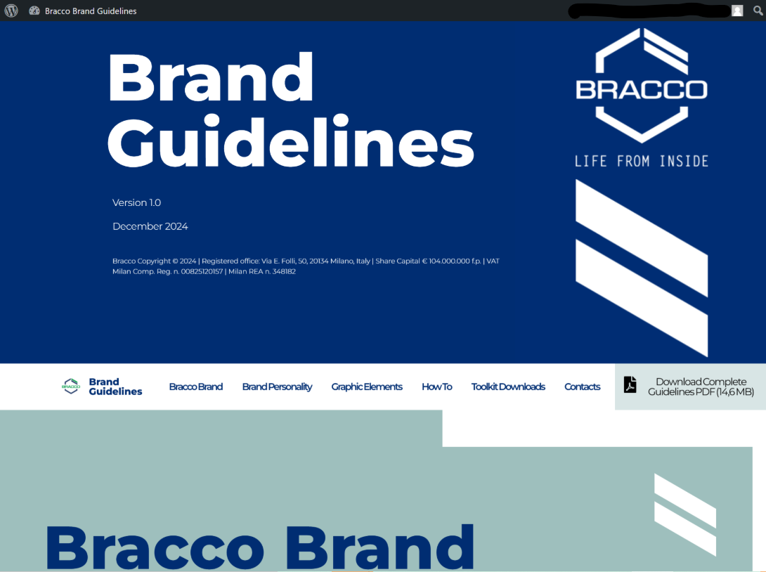
Brandguidelines.bracco.com
Login

Slide 20
Thank you!

Slide 21
FOLLOW US
ON OUR DIGITAL MEDIA CHANNELS
LinkedIn YouTube bracco.com

